Slide 1

CREDIT CARD FRAUD DETECTION
Prepared By:
IRA SHARMA (47013302816)
MUDITA SHARMA (48513302816)
HARSHITA SHARMA (35813302816)

Slide 2

INTRODUCTION….
As credit card becomes the most popular mode of payment for both online as well as regular purchase, cases of fraud associated with it are also rising.
To analyze the spending patterns on every card and to figure out any inconsistency with respect to the “usual” spending patterns.
Fraud detection based on the analysis of
existing purchase data of cardholder is a
promising way to reduce the rate of
successful credit card frauds.
Every cardholder can be represented by a set of patterns containing information about the typical purchase category, the time since the last purchase, the amount of money spent, etc. deviation from such patterns is a potential threat to the system.

Slide 3
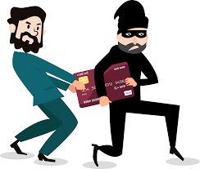
PROBLEM STATEMENT
With the great facility to buy anything, anywhere without money or with virtual money, Credit card brings the successful fraud transactions too.

Slide 4

SOLUTION?
In proposed system, Behavior and Location Analysis (BLA) concept will be used, which is able to detect frauds by considering a cardholder’s spending habits.
A drastic reduction in the number of False Positives transactions identified as malicious by an Fds(fraud Detection System) .
Each incoming transaction is submitted to the FDS for verification. FDS receives the card details and the value of purchase to verify, whether the transaction is genuine or not.

Slide 5
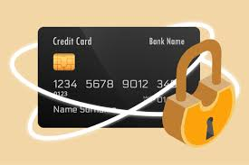
Continued…..
The credit card fraud detection features uses user behavior and location scanning to check for unusual patterns.
These patterns include:
user characteristics
user spending patterns
usual user geographic locations
These characteristics include:
user country
usual spending procedures
So now the system may require the user to login again or even block the user for more than 3 invalid attempts.

Slide 6
ALGORITHMS
SOFTWARE
&
SOFTWARE USED:
Windows10
Python basics
Jupyter Notebook
ALGORITHM USED:
Local outlier factor
Isolation forest
Support Vector Machine (SVM)

Slide 7
DATASET
The datasets contains transactions made by credit cards in September 2013 by European cardholders. This dataset presents transactions that occurred in two days, where we have 492 frauds out of 284,807 transactions. The dataset is highly unbalanced, the positive class (frauds) account for 0.172% of all transactions.
It contains only numerical input variables which are the result of a PCA transformation. Unfortunately, due to confidentiality issues, we cannot provide the original features and more background information about the data. Features V1, V2, ... V28 are the principal components obtained with PCA, the only features which have not been transformed with PCA are 'Time' and 'Amount'. Feature 'Time' contains the seconds elapsed between each transaction and the first transaction in the dataset. The feature 'Amount' is the transaction Amount, this feature can be used for example-dependent cost-sensitive learning. Feature 'Class' is the response variable and it takes value 1 in case of fraud and 0 otherwise.

Slide 8
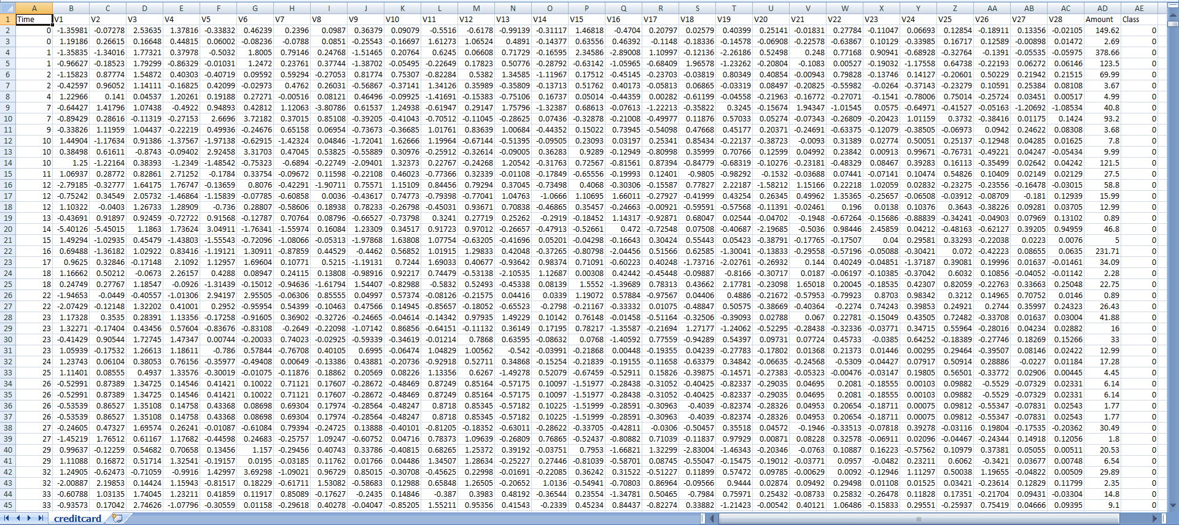

Slide 9
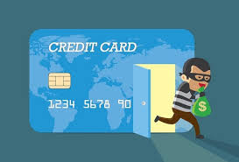
LOCAL OUTLIER FACTOR
Local density
locality is given by nearest neighbors, whose distance is used to estimate the density.
The local density of an object to the local densities of its neighbors, one can identify regions of similar density
And points that have a substantially lower density than their neighbors. These are considered to be outlier.

Slide 10
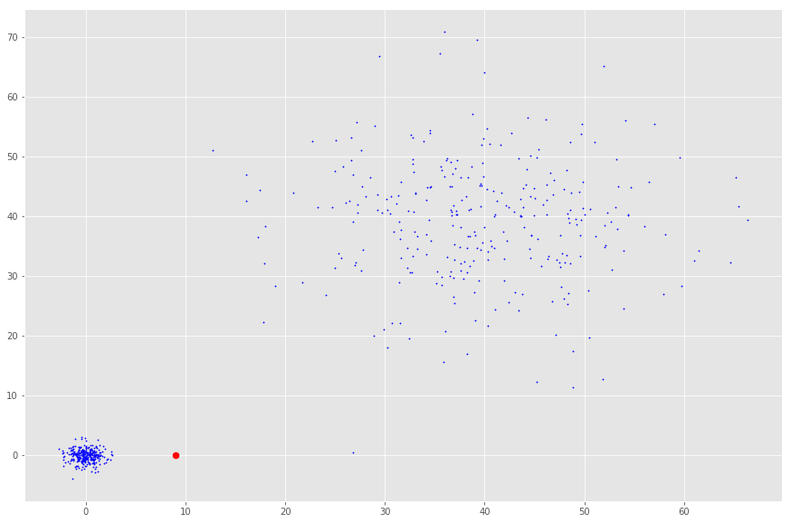
CONTINUED…..
The local density is estimated by the typical distance at which a point can be "reached" from its neighbors.
FIGURE: Basic idea of LOF: Comparing the local density of a point with the density of its neighbour. A has a much lower density than its neighbour.

Slide 11
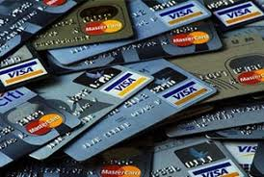
ISOLATION FOREST
The Isolation Forest ‘isolates’ observations by randomly selecting a feature and then randomly selecting a split value between the maximum and minimum values of the selected feature.
The number of splitting required to isolate a sample is
= to the path length from the root node to the terminating node.
This path length, averaged over a forest of such random trees, is a measure of normality and our decision function.
Random partitioning produces noticeably shorter paths for anomalies.

Slide 12
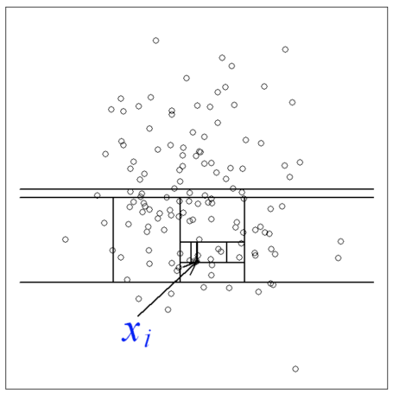
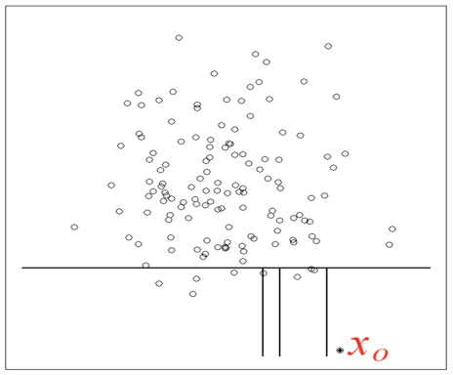
Isolation Forest
Normal point
Outlier

Slide 13
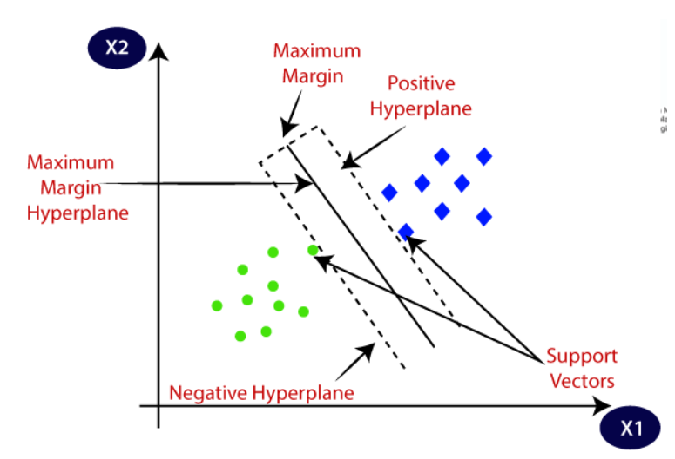
SUPPORT VECTOR MACHINE
Support Vector Machine (SVM)
capable SVM of performing classification
regression
and even outlier detection.
The linear SVM classifier works by drawing a straight line between two classes.
All the data points that fall on one side of the line will be labeled as one class and all the points that fall on the other side will be labeled as second.
Sounds simple enough, but there’s an infinite amount of lines to choose from.

Slide 14

CORE FEATURES OF SYSTEM
The system stores previous transaction patterns for each user.
Based upon the user spending ability and even country, it calculates user’s characteristics.
More than 20 - 30 % deviation of user’s transaction (spending history and operating country) is considered as an invalid attempt and system takes action.

Slide 15

ADVANTAGES
Due to Behavior and location analysis approach, there is a drastic reduction in the number of False Positives transactions identified as malicious by an FDS although they are actually genuine..
The system stores previous transaction patterns for each user.
Based upon previous data of that user the system recognizes unusual patterns in the payment procedure.
The System will block the user for more than 3 invalid attempts.

Slide 16
RESULTS…..

Slide 17
CLASSIFICATION REPORT
A Classification report is used to measure the quality of predictions from a classification algorithm.
Classification Report Metrics are as follows
Precision: Accuracy of positive predictions.
Precision = TP / (TP + FP)
Recall: Fraction of positives that were correctly identified.
Recall = TP/(TP+FN)
F1 Score: It is the weighted average of Precision and Recall.
F1 Score = 2*(Recall * Precision) / (Recall + Precision)
Support: It is number of occurrences of each class in correct target values.

Slide 18
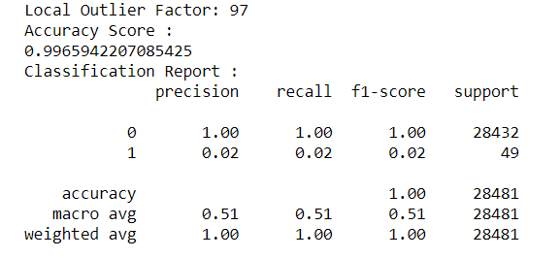
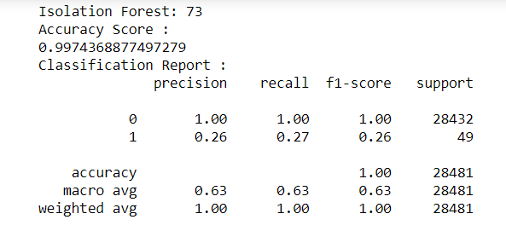
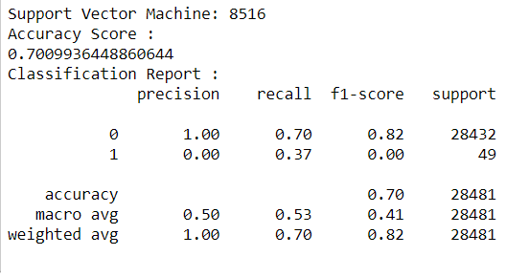
LOF
I F
SVM

Slide 19
CONCLUSION
The Isolation Forest performed much better than SVM and similar to the LOF .
So overall Isolation Forest Method performed much better in determining the fraud cases with an accuracy of around 99.76%.
We can also improve on this accuracy by increasing the sample size or use deep learning algorithms however at the cost of computational expense. We can also use complex anomaly detection models to get better accuracy in determining more fraudulent cases.
IF
683
99.76%
LOF
935
99.67%
SVM
71078
75.52%

Slide 20
FUTURE SCOPE
Despite of these outstanding techniques, there will always be a percentage of frauds prevailing, until we integrate good security software/hardware with present software/hardware available in the market. There is always a possibility for improvement. So, for the future scope:
we can add fingerprint sensor in ATM machines to avoid fraudulent transactions. Nowadays, we all use mobile phones or laptops for making transactions. The inbuilt camera in these devices can act as the most useful aid for security.
We can also add Iris Detection System in bank’s software or mobile application. Whether the user uses mobile phone or laptop for the transactions, it will be a safe transaction if the bank’s software is integrated with Iris Detection System.
We can also add Face detection System with the bank’s software.

